Slide 1




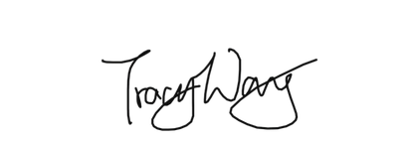
CERTIFICATE
ADYPSOE
of Participation
This Certificate is Proudly Presented to
{{name}}
In recognition of your active participation and enthusiastic involvement in the AWS Expert session
FROM LOCALHOST TO CLOUD held on 26th Feb 2026
Community Program Manager
AWS CLOUD CLUBS

